Slide 1

Applying the Problem Solving Platform
The Department of Energy’s
Lighting Market Characterization Report
Notes:
I’ll go ahead and dive right in.
I will be describing a past project I worked on, as well as considering improvements that could be made using SparkBeyond’s Problem Solving Platform
The project I’ll be discussing is a report I co-authored in a past consulting role for the Dept. of Energy called the Lighting Market Characterization, or LMC.

Slide 2
Agenda
1.
The Project Workflow
The Cross-Industry Standard Process for Data Mining:
Business Understanding
Data Collection & Understanding
Data Preparation
Modeling & Evaluation
Deployment
Business Understanding
Data Understanding
Data
Data Preparation
Deployment
Evaluation
Modeling
Applying SparkBeyond
Data Collection
Modeling
Insights
Impact
2.
Notes:
Before I delve into details of the project, here is a quick overview of what I’ll be discussing today.
First, I’ll go through the LMC, sticking roughly to the CRISP-DM structure:
Understanding the need for the analysis, followed by
The process of collecting data and preparing it. Next, the
Modeling and evaluation phase.
After I’ve worked my way through those details, I will walk through ways in which the problem solving platform could really enhance the analysis.
With that in mind, I’ll get started.

Slide 3


The “Why”
Provides a holistic understanding of lighting nationwide
Results guide DOE R&D project selection
Public data source for a field with little available data
Available here as 135 page report and corresponding Excel file
Expands upon previous 2002 and 2012 reports
Navigant Consulting
Authors:
Nicole Buccitelli
Clay Elliott
Seth Schober
Mary Yamada
Notes:
So, here’s a bit about the LMC and why it exists.
Above all else, its goal is to provide a detailed and comprehensive analysis of the lighting sector nationwide since there really aren’t any comparably comprehensive studies.
The DOE’s Office of Energy Efficiency spends quite a bit of money on R&D grants, including for energy efficient lighting
They wanted an understanding of the market so they could determine both where improvement is most needed and measure impact after awarding the grants
It is also meant to be a piece of standalone research for public use, which is, of course, inherently valuable.

Slide 4
Breaking Down the Problem
All Lighting
Technologies (LED, CFL, etc.)
Residential
Commercial
Industrial
Outdoor
Single-Family
Multi-Family
Mobile Home
Education
Food Sales
Retail
…
…
…
Lodging
Paper
Food
Petroleum
…
…
…
Electrical Equip.
Airfield
Billboard
C&I Exterior
Comm. Tower
Parking
Railway
Roadway
Sports
Traffic Signal
Room Type
Notes:
So, to break it down a bit, when I say lighting, I mean the goal is to analyze every single light in the country. Well, except vehicles.
This chart shows how we split it up
I’ll spare you from reading them all, but essentially we started by breaking lighting into each lighting technology and bulb type, then continued into four sectors and many subsectors

Slide 5
Collecting the Data
Source Types Used in Analysis
Notes:
As it turned out, getting ahold of the data we needed ended up being the most time consuming portion by far.
We had to be creative in terms of where to look, how in depth to go, and how to validate it all
Large datasets were prioritized whenever possible, though we also had a large network of subject matter experts to help fill in the holes

Slide 6
Top Sources
A few of the main sources:
Lighting trade association shipment data (NEMA)
Energy Information Administration (EIA)
Interviews & subject matter expert feedback
Sources ranged from common to obscure:
US Census for fundamental residential metrics
FCC’s Antenna Structure Registration Database
Notes:
Just to give you a quick glimpse into that process, here are some of our top data sources.
1st, lighting shipment data was incredibly valuable for determining mixes of different lighting technologies, as well as efficiency trends
EIA makes high quality data about the energy sector publicly available, so that was a valuable tool for sure
Lastly, like I mentioned before, interviews and subject matter expert feedback were vital as well
But those sources aside, I actually found it interesting to look back and see how wide of a net we needed to cast
The easiest data was from places like the Census, which was used for residential data, but
Weirdly obscure sources also needed to be used for the less mainstream subsectors. My favorite was the FCC’s Antenna Structure Registration Database, which we used for insights on communication tower lighting.

Slide 7
Example: Collecting Traffic Light Data
Examples of answered questions:
How many (signalized) intersections are there nationwide?
Federal Highway Administration: 1 per 1,000 people
Institute of Transportation Engineers: 337,000 as of 2012
American Assoc. of State Highway and Transportation Officials: 1 per 860 people
Dept. of Transportation: total growth of 1.5% per year
How much how power does one light use?
Energy Star mandates certain efficiencies for those manufactured after 2005
Web scraping gives efficiency ranges
Turnover estimated by subject matter experts
Notes:
Anyways, since so much of the project was data collection, I’ll give an example here as well.
As it turns out, there’s not much public data about traffic signals, so that took a lot of digging.
Here, I ended up doing quite a few interviews to get the various estimates I listed here.
Anyways, while it did lead to enough data to assemble an analysis, you can see that in many cases these are just data points, so statistical testing was off the table.
While applying ML models would be ideal, for most of the project it was either infeasible given the amount of data or impractical given the project budget
That’s where SparkBeyond would bring the analysis to a whole new level. But I will talk about that more down the road.

Slide 8
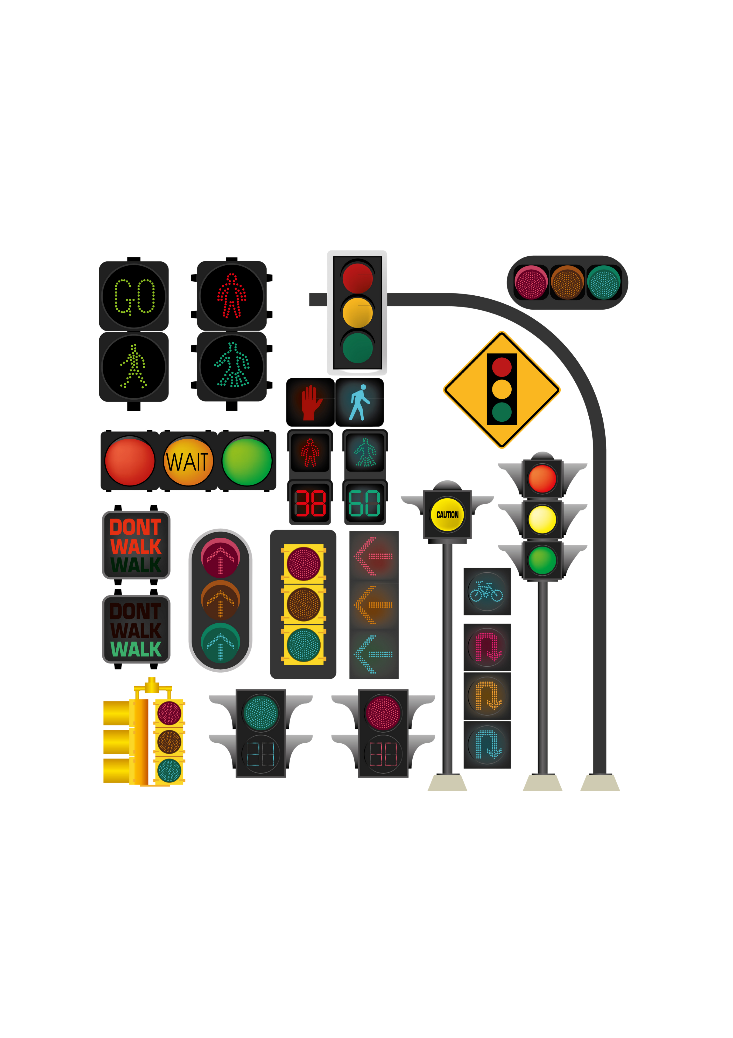
Feature Engineering Example
How long does an average traffic light bulb operate daily?
type
bulbs per intersection*
hours per day
bulb-hours
8
8
64
2.5
1.7
4.3
4.2 hours per day
6.6
14.4
95
0.2
9.6
1.9
* per Federal Highway Administration
Notes:
In terms of manipulating inputs, here’s a quick example of both the type of data that needed to be collected and some simple feature engineering
Here, the end goal is to figure out how long a generic traffic signal operates per day (breaking it into pedestrian signals and arrows wasn’t really helpful for this scope of work).
But different types of signals operate very differently
So we started small and worked our way up
Thankfully, this is one place where we were able to get relatively precise breakdowns.
The down side is that there is no way to validate the number of bulbs per intersection, so this is another case of limited ability to validate features.
That said, it is good enough to give us a foundational understanding.

Slide 9
Modeling Overview
Descriptive analytics process
Individual feature verification was prioritized over creating ML model
“Simple” outputs (inventory, operating hours, technology mix, power consumption) based on complex inputs
Tools Used
Excel
R
Analytica
Average Operating Hours
Lighting Inventory
Power Consumption
Controls Impacting Operating Hours
Controls Impacting Wattage
Total Power Consumption
Notes:
Okay, that brings us to modeling.
Like I mentioned before, limited datasets made regression infeasible in many cases so the analysis is based largely on weighted averages, starting with the smallest market segments possible.
In the case of the residential sector, those subsectors were relatively granular given how much data is available.
The outdoor sector, on the other hand, was really hard to get large amounts of data for.
That’s one place that I would hope the problem solving platform could provide some unique value
And lastly, as a side note, most of the analysis was done in Excel, though R and Analytica were used as well.

Slide 10
Results: Energy Consumption
Notes:
I’m not going to spend much time on results since that’s not why we’re here, but here is a quick glimpse
Overall, lighting in the Commercial sector consumes the most energy, followed by Outdoor and Residential

Slide 11
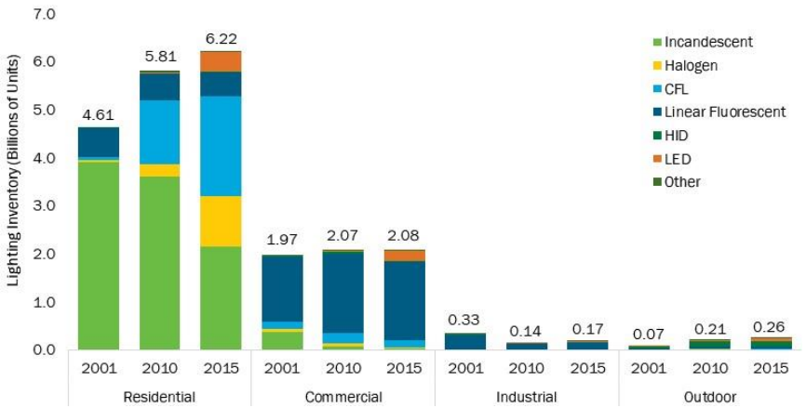
Validating Results
Primary Methodologies:
Extensive peer review of features and outputs
Cross-validation between input datasets as possible
Comparison with results of 2010 analysis
Source | Model Year | Annual Lighting Electricity Consumption (TWh/yr)
Residential
LMC, 2002 | 2001 | 208
LMC, 2011 | 2010 | 175
EIA, AEO 2011 | 2010 | 208
EIA, AEO 2016 | 2015 | 143
LMC, 2015 | 2015 | 149
Commercial
LMC, 2002 | 2001 | 391
CBECS, 2003 | 2003 | 393
EIA, AEO 2011 | 2010 | 299
LMC, 2011 | 2010 | 349
CBECS, 2016 | 2012 | 212
EIA, AEO 2016 | 2015 | 254
LMC, 2015 | 2015 | 237
Industrial
LMC, 2002 | 2001 | 108
MECS, 2006 | 2003 | 58
LMC, 2011 | 2010 | 58
MECS, 2013 | 2010 | 48
LMC, 2015 | 2015 | 53
Outdoor
LMC, 2002 | 2001 | 87
LMC, 2011 | 2010 | 195
LMC, 2015 | 2015 | 202
Notes:
Of course validating those results was an essential portion as well
Our first level of a “sanity check” is in the table you see here.
It compares the results to reports that looked into similar topics
Though this couldn’t be used as more than a high-level check since none were as comprehensive as the LMC
The second check was comparing to previous LMC editions.
We broke that down to a much more granular level than you see there, but the graph shows a high-level overview for each sector
Overall, we see a growth in inventory and a transition away from less efficient technologies, as would be expected.
Looking into these results and their limitations brings us to the next section: applying the problem solving platform.

Slide 12
The Problem Solving Platform How can it help?
Data Collection
Modeling
sizes and interviews
Advancing from simplified Data
Moving beyond limited sample
Analytics to ML and AI
Insights
Impact
unexplored relationships
Accurate micro-segmentation
Understanding of previously
to best allocate R&D funds
Notes:
Based on what I’ve seen so far, I chose to break the value of the problem solving platform into these four categories
First is data collection. Like we’ve talked about, a substantial amount of the project was just aggregating hard-to-find data. This is one place where the platform seems to thrive. I’ll walk through a speculative example on the next slide.
Second is modeling. With enhanced data collection, more advanced regression techniques will be feasible both for validating the results and finding new insights
Third is the insights that come from exploring new relationships that hadn’t been considered yet.
Lastly, the impact needs to be tangible. Beyond providing an accurate source of information for public use, it should be able to more accurately guide R&D funding decisions
I’m going to walk through speculative examples for each of these main categories.

Slide 13
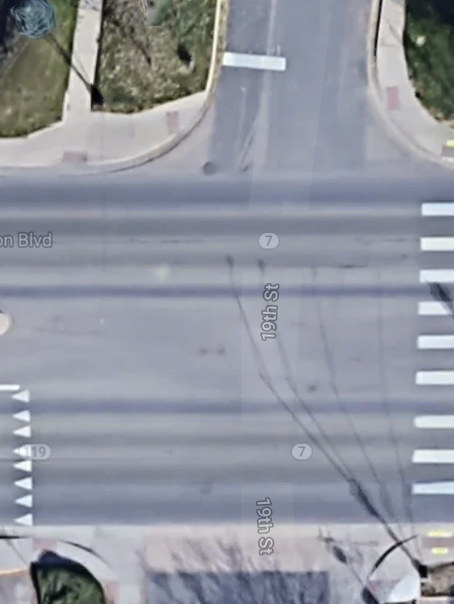
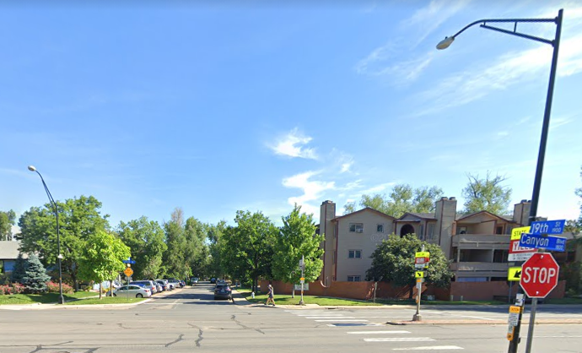
Data Collection: Roadway Lighting
Substantial potential for error in inventory estimates
The ideal solution: “just” count the number of lights
Option 1. Street view (best choice)
Option 2. Satellite view (likely better than current approach)
Option 2
The more realistic solution:
Count lights for select cities
Count lights for select highways
Implement ML model to scale nationally
Option 1
Notes:
One feature I spent substantial time on was determining roadway lighting inventory
In the end, the inventory was based on data from dozens of interviews that I conducted with both cities and state DOTs
This is where I would hope the platform could provide significant value
I know it makes use of Open Street Maps, though I don’t know details beyond that.
If it was able to essentially use ML to figure out what a light pole looks like, it could crawl through the networks of streets in a city to provide a count
I have no idea how feasible this would be.
Afterwards, proxy features could be used to scale the data from select cities to a national level.
If street lighting wasn’t an option, highway lighting would at least be less time intensive given that lower level of complexity compared to a network of streets.
Given that highways are maintained on a state level instead of local level, technology mixes are also easier to get an accurate estimate of, though this will inevitably be based on interviews
I would be curious to get your perspective on whether this seems feasible to you.

Slide 14
Modeling Enhancements
Unleash machine learning and AI
Using comprehensive regression techniques instead of an analysis built on aggregating simple averages
Statistical model validation to augment existing peer review and source data cross-validation
Notes:
Built on this increased availability of data, additional regression techniques will become feasible in ways that weren’t before
Regression is only possible when surpassing a certain baseline level of data, which for many features wasn’t an option. Once we have that data, it will open up the scope of the project entirely

Slide 15


Expanding Insights
We don’t know what we don’t know.
The key benefit is a tool to help escape the cognitive bottleneck
Linked Data Core likely provides access to beneficial datasets
Notes:
Beyond specific examples, it seems that the value comes from escaping the cognitive bottleneck. For that reason, I think one of the most valuable aspects is seeing what sort of relationships the platform is able to derive.
I also don’t know what data is within the linked data core, aside from the basics that were discussed in the videos, but there seems to be an immense amount more than that. I think perusing the platform would inevitably spark valuable ideas

Slide 16
Realized Impact
Micro-segmentation to further understand R&D needs
DOE’s lighting R&D spend to date: $480M
DOE’s estimated ROI: $10B in energy savings
Determining the field with the highest potential ROI can guide investments better than the current broad methodology
SparkBeyond delivers micro-segmentation to achieve this goal
Notes:
And finally, the impact of these enhancements is essential to understand
First, keeping in mind that the analysis guides DOE R&D funding, further micro-segmentation of the industry provides opportunity for a more targeted approach
Second, given that the analysis serves as a public source of data, accuracy is essential so that future analyses aren’t built on a weak foundation.

Slide 17
Contact Information
Seth Schober
seth.schober@gmail.com
linkedin.com/in/sethschober
(585) 200-0293
Notes:
And that brings us to the end
All in all, if I were working on the LMC, I would be really excited to have the problem solving platform as a tool, and I’m sure there’s way more to learn about than I touched on here.
Do you have any questions?

